Slide 1



REPETITIVE STRAIN INJURIES
PRABAL GUPTA
DANIEL WEISBERG ANURAG JOSHI

Slide 2

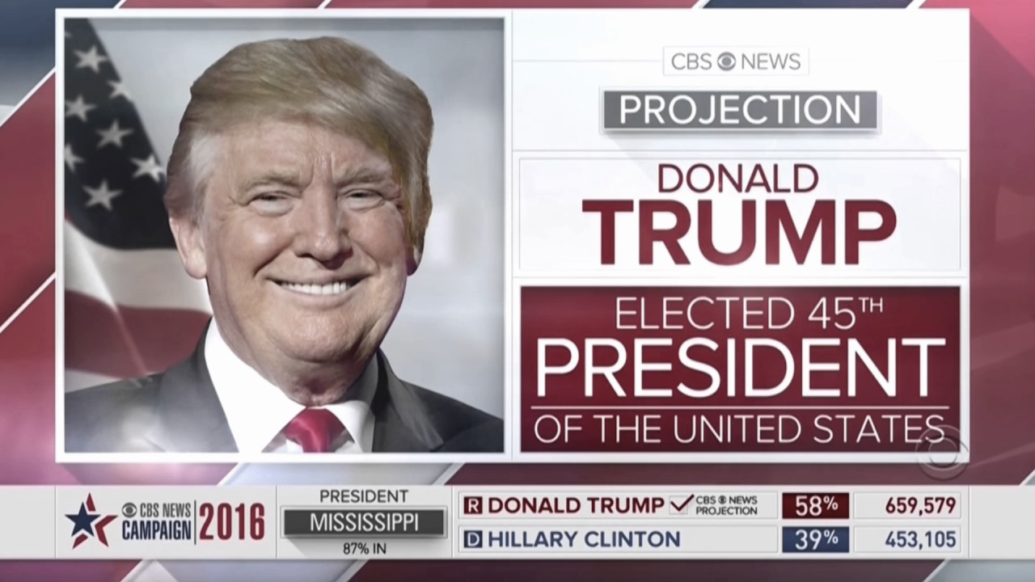



Slide 3
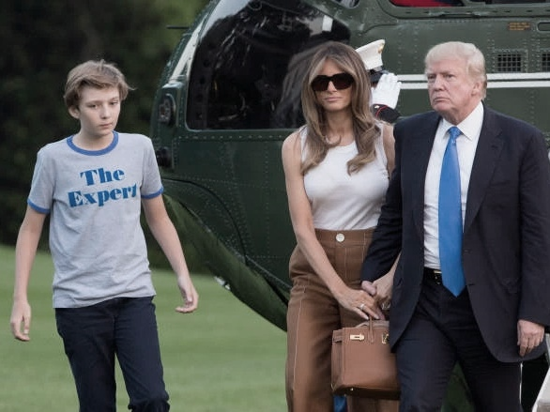


Slide 4
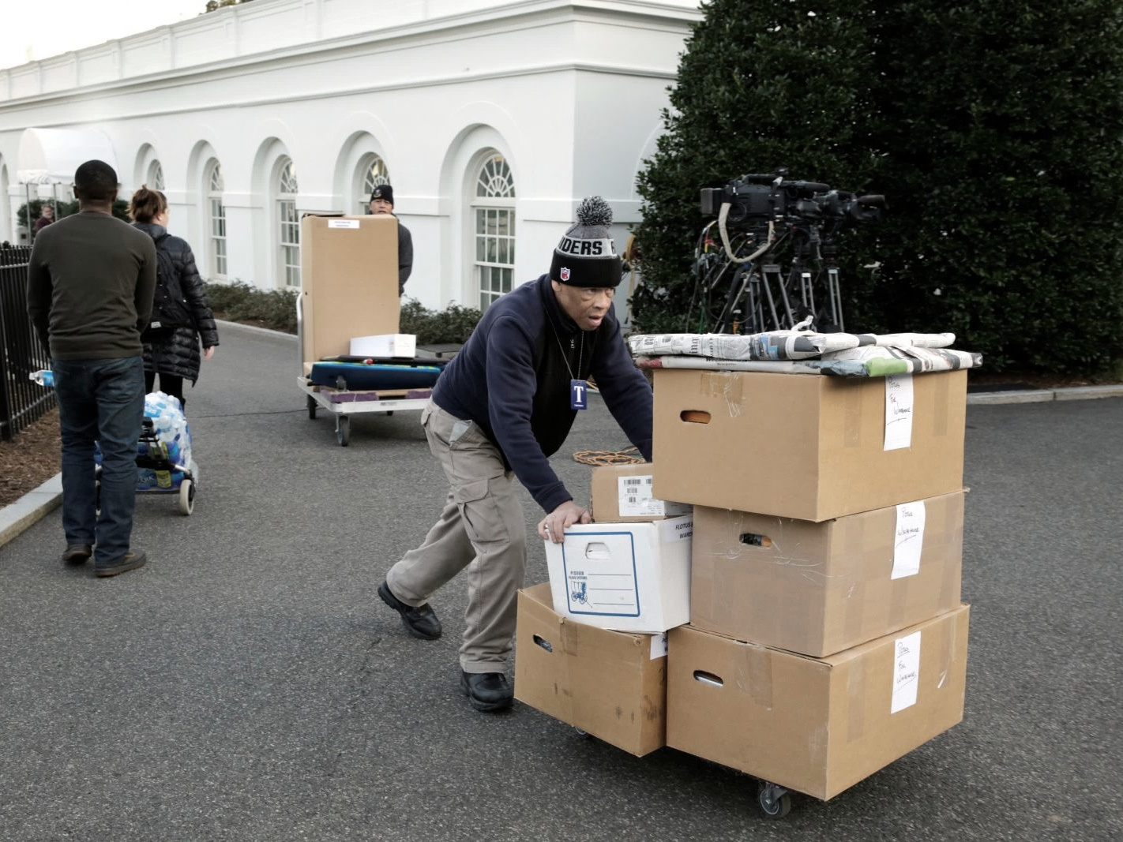


Slide 5
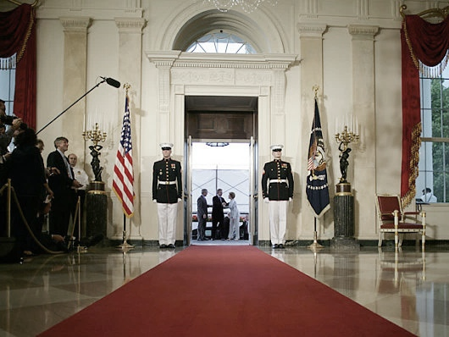



Slide 6
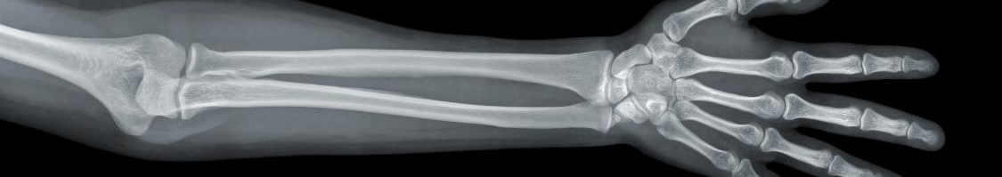
REPETITIVE STRAIN INJURY
Repetitive Strain Injuries (RSIs) are work-related overuse injuries caused by:
Repetitive Tasks
Forceful Exertions
Vibrations
Mechanical Compressions
Sustained, Awkward Posture
NO SHORT-TERM TREATMENT IS AVAILABLE
EARLY DIAGNOSIS IS CRITICAL TO LIMITING DAMAGE
Notes:
1.) https://en.wikipedia.org/wiki/Repetitive_strain_injury
2.) https://en.wikipedia.org/wiki/Repetitive_strain_injury#Treatment

Slide 7
PROBLEM DEFINITION
No. 1
2nd
REPORTED TYPE OF OCCUPATION ILLNESS
LARGEST CAUSE OF DISABILITY WORLDWIDE
INDUSTRY LACKS EFFECTIVE WAYS TO PREDICT AND PREVENT ONSET OF REPEATITIVE STRAIN INJURIES
Notes:
For the Numbers: (top-left article at following link) https://www.sciencedirect.com/topics/medicine-and-dentistry/repetitive-strain-injury

Slide 8
PROBLEM IMPORTANCE
LOST WORK-DAYS
REDUCED QUALITY OF LIFE
DEBILITATING, CHRONIC DISORDERS
RSIs CONSITUTE 1/3 OF ALL WORK-RELATED INJURIES RSIs SEVERELY IMPACT QUALITY OF LIFE AND PRODUCTIVITY
Notes:
For the Numbers: (top-left article at following link) https://www.sciencedirect.com/topics/medicine-and-dentistry/repetitive-strain-injury

Slide 9


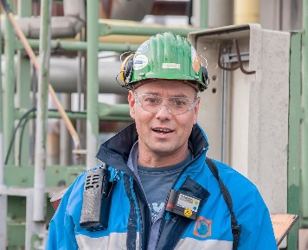

STAKEHOLDERS
DIRECT
1 |
BLUE-COLLAR WORKERS, ESPECIALLY CONSTRUCTION AND WAREHOUSE WORKERS
BUSINESSES THAT PROVIDE BLUE-COLLAR SERVICES
2 |

Slide 10
STAKEHOLDERS
1st
34%
CAUSE OF LONG-TERM PAIN WORLDWIDE
OF LOST-WORKDAY INJURIES ARE RSIs
23
^{$80 Billion}
DAYS AWAY FROM WORK (MEDIAN) PER INJURY
ANNUAL COST OF RSIs IN THE UNITED STATES
Notes:
(top-left article at following link) https://www.sciencedirect.com/topics/medicine-and-dentistry/repetitive-strain-injury
http://www.rsi-therapy.com/statistics.htm

Slide 11
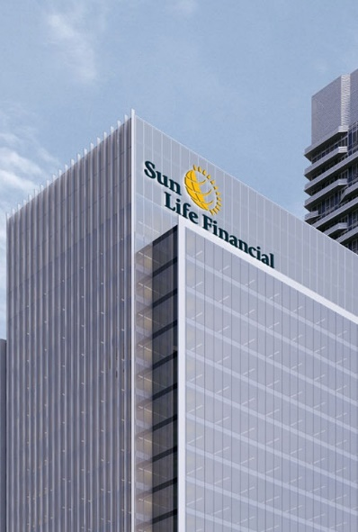

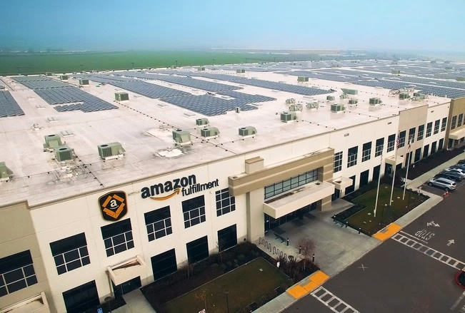
STAKEHOLDERS
INDIRECT
1 |
CUSTOMERS OF BLUE-COLLAR SERVICES
2 |
HEALTHCARE INFRASTRUCTURE
3 |
INSURANCE COMPANIES

Slide 12
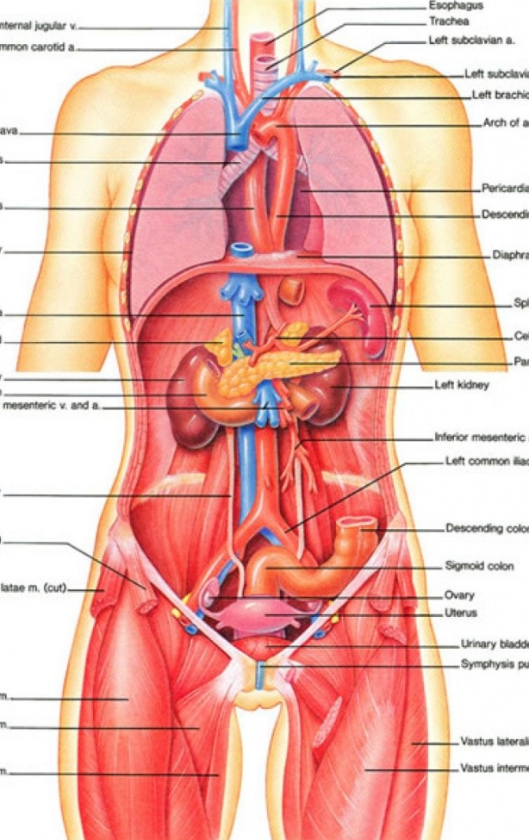
PROBLEM MISTAKES
1
MANUAL METHODS
INACCURATE INCOMPLETE REQUIRE TRAINING
2
AUTOMATED METHODS
EXPENSIVE RESEARCH DOMAIN UNSCALABLE OBSTRUCT WORK

Slide 13
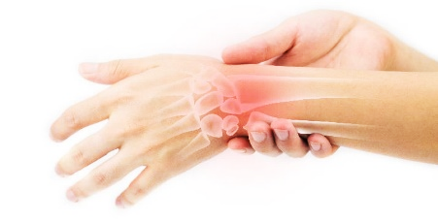

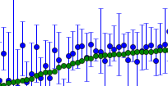

AFFORDABLE, SCALABLE
SOLUTION CONSTRAINTS
1
3
FUNCTIONALLY UNOBTRUSIVE
2
INTERPRETABLE DATA

Slide 14
PROBLEM STATEMENT
INDUSTRY NEEDS SIMPLE, INEXPENSIVE, SCALABALE, AND UNOBSTRUSIVE TOOLS TO PREDICT ONSET OF RSIs

Slide 15
THANK YOU

Slide 16



